Slide 1

Is a college education a good investment?

Slide 2

Strategy
Collect information on:
Student loans
Income based on education and location
Investigate the differences in median income and federal student loans with respect to the following:
Create dashboard to determine WHEN a college education starts to pay off depending on where you live and what you study.
Education attained
State of residence
Major of study

Slide 3

Questions to answer
Are there some locations where an education is a better or worse investment?
Are there some majors that are a better investment than others?
Is a college education a good investment overall?

Slide 4
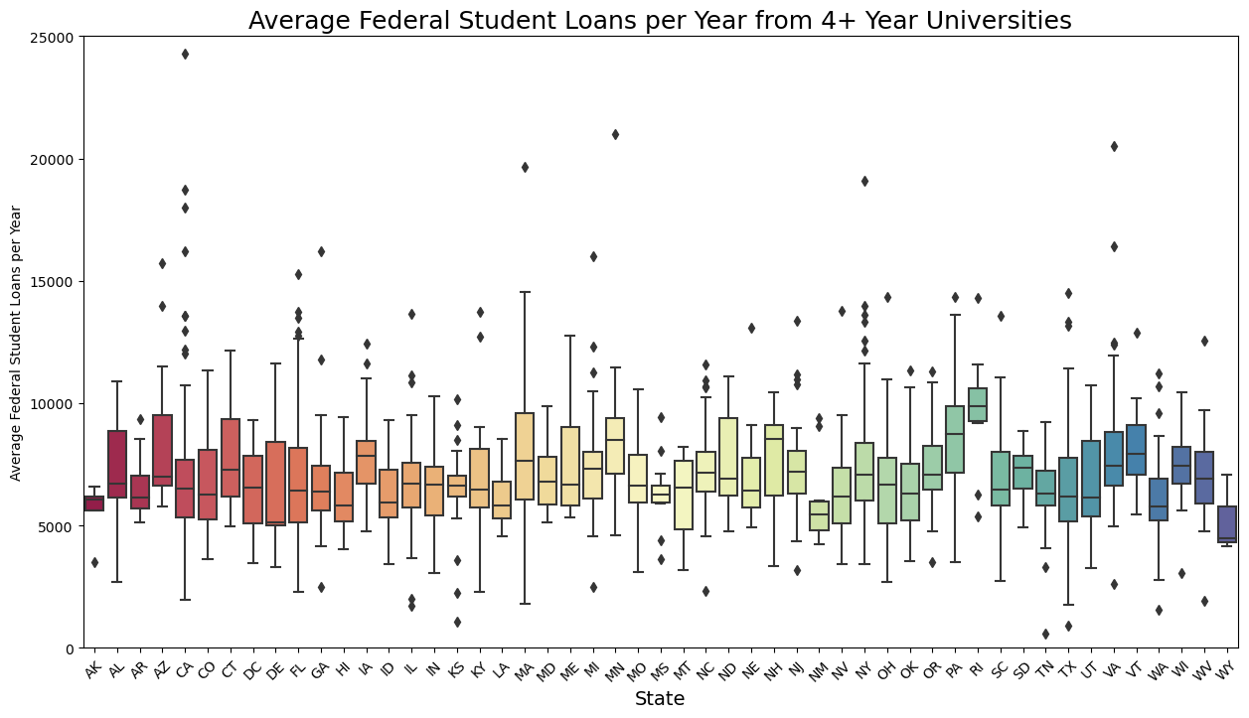
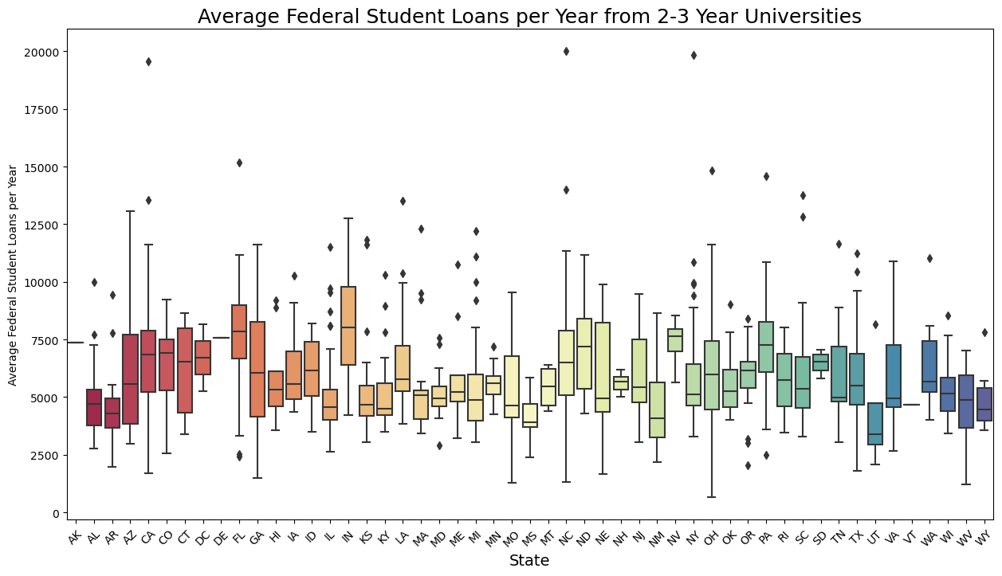
Federal Student Loan Data
There is some variability in terms of student loans.
The amount of variability does not vary greatly from state to state.

Slide 5
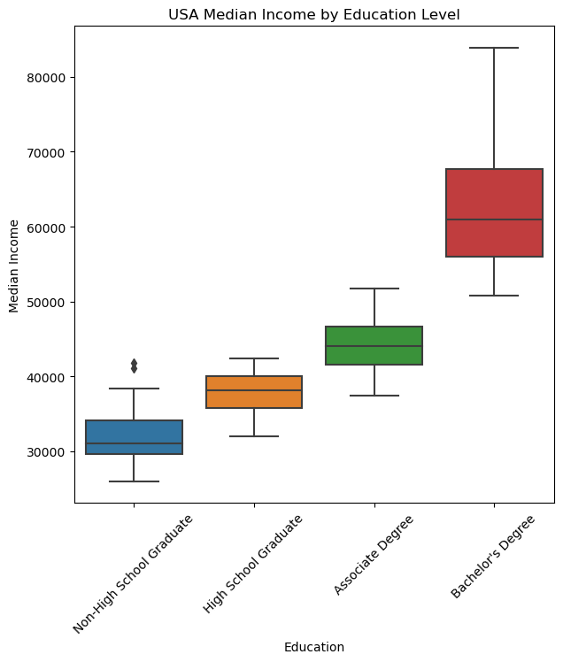
Median income increases based on education.
Does this trend hold true everywhere in the United States?
Notes:
Change salary to income.

Slide 6
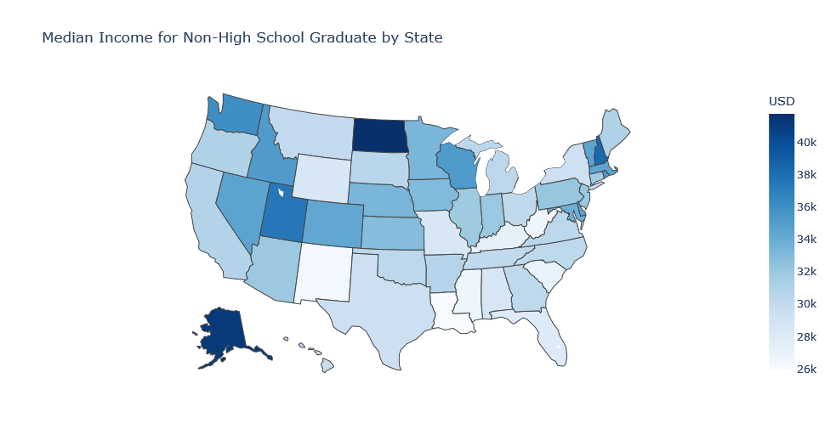
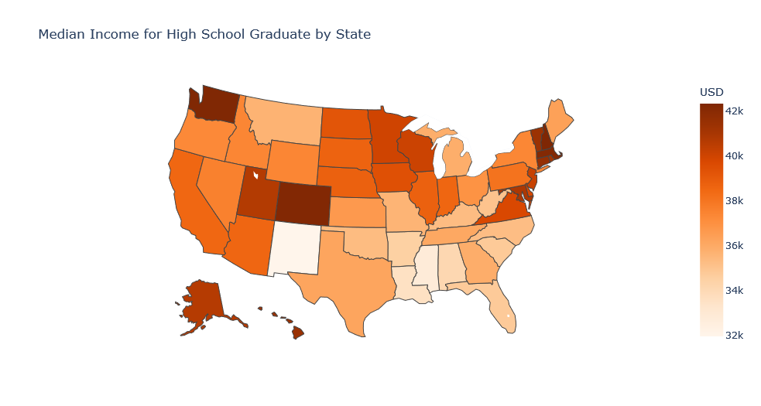
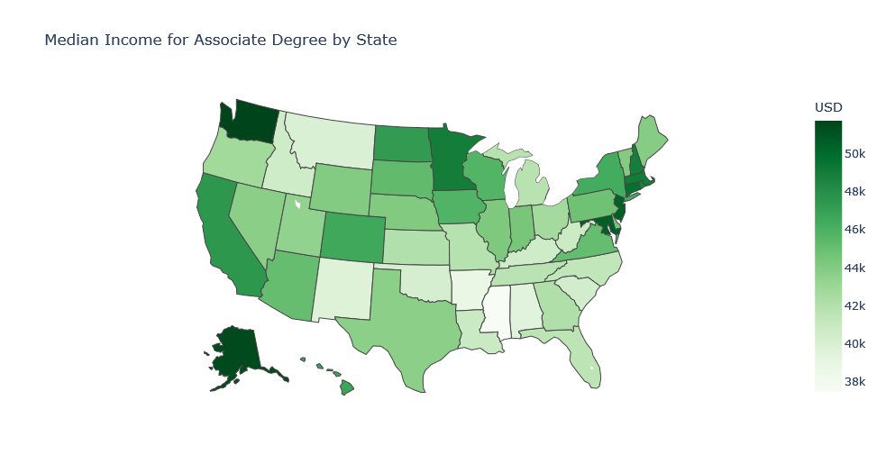
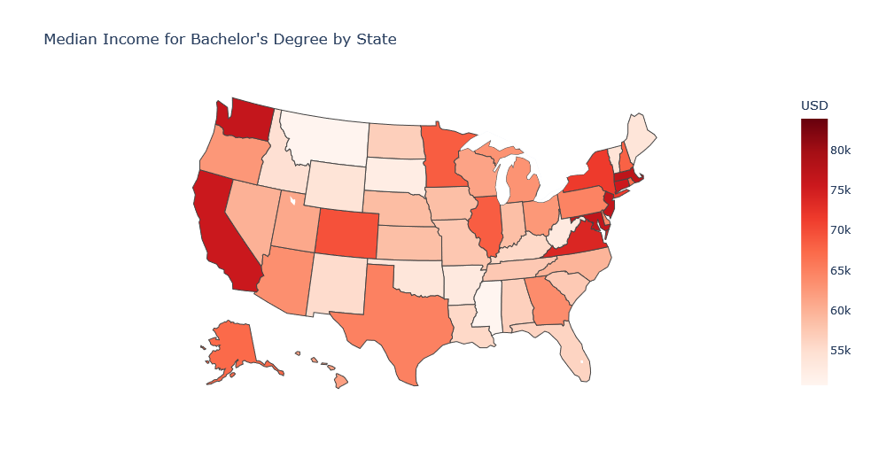

Slide 8
Does your choice of major matter?

Slide 9
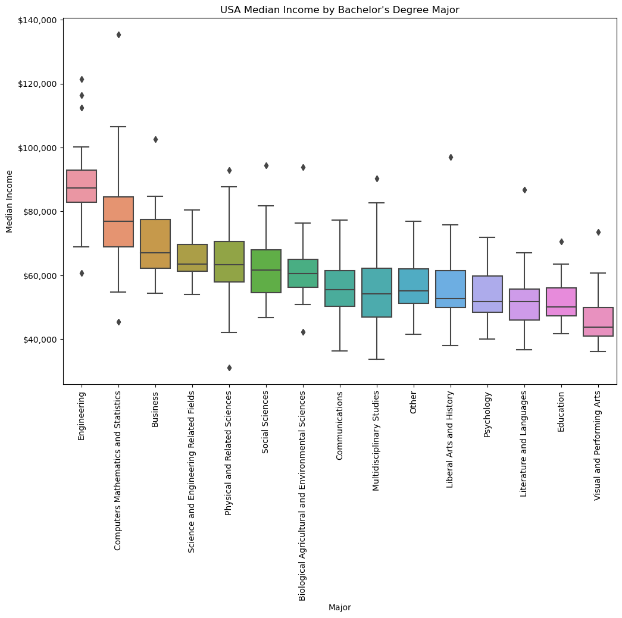
There are a few outliers in terms of education and income.

Slide 10




How do we measure if education is a good investment?
Imagine that you had to decide between four options:
Leave high school at age 16
Graduate high school at age 18
Graduate with an associates at age 20
Graduate with a bachelor’s at age 22
Which decision makes the most sense financially?

Slide 11


Slide 12

Conclusions
Education is a good investment in general. Most people with more education will end up making more money overall.
Money isn’t the most important thing.
Education opens up many doors for a person’s career and doing a job you enjoy is often more important to lots of people than just income.
However, if income is important then location and major definitely matter!

Slide 13

Questions?

